Slide 1
Diversity and Equity Advisory Committee
Report to College Council
April 24, 2013

Slide 2
Purpose
The members of the South Puget Sound Community College Diversity and Equity Advisory Committee voluntarily serve on this Committee with the purpose of:
Identifying, dismantling or otherwise addressing institutional barriers to student success that pertain to a student’s membership in historically marginalized or underrepresented group(s);
Creating an avenue for students from historically marginalized communities to communicate their educational needs to the institution.

Slide 3
Purpose
Supporting institutional responsiveness to the needs of the many cultural and identity groups present in our student body by:
identifying specific barriers
providing opportunities for staff and faculty professional development
making recommendations for policy change, student support or resources to the administration or other appropriate SPSCC departments or divisions.

Slide 4
Mission
To increase student engagement, retention and completion among all students at SPSCC, paying particular attention to students from historically underrepresented or marginalized communities.

Slide 5
Objectives
Inclusive Excellence: “There is no excellence without diversity.” Support for diversity and equity initiatives improves learning for all students:
Keeping track of “opportunity gaps” and climate
Advocating for faculty and staff diversity
Increasing resources for cultural competency development among current employees

Slide 6
Strategies
Climate surveys
Focus groups
Brown bag lunches
Professional development opportunities

Slide 7
Structure
The DEAC consists of 30 members. We meet on the first Friday of each month to discuss progress on our various goals and to plan upcoming events.
The DEAC has four subcommittees that focus on the needs of the following groups:
LGBTQ students
Students of Color
Students with Disabilities
Veterans

Slide 8
Subcommittees
Meet on an ad hoc basis to
Discuss and/or design climate surveys
Recommend professional development
Make other recommendations for action

Slide 9
LGBTQ Students Subcommittee
“LGBT-friendly Campus Climate Index” (2010-2011)
LGBT Students focus group (May 2012)
Goals: increase sense of safety and inclusion among LGBT-identified students
Promote cultural competency among faculty/staff/students
Respond to increased need for gender-neutral restrooms; protocol around restroom use
DEAC sponsored these events in response to findings:
“Pride” lunches for LGBT students led by SPSCC staff
Increased cultural competency training on transgender awareness
Support for increased numbers of gender-neutral restrooms, especially in new construction

Slide 10
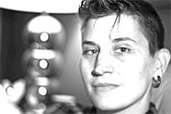
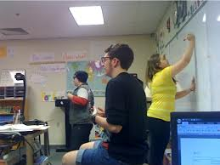
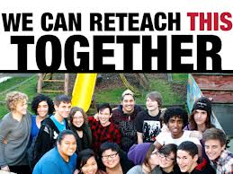
LGBTQ Awareness Professional Development Workshops
Student panels
Creating an Inclusive Environment for Transgender and Gender Non-Conforming Individuals, Talcott Broadhead, MSW
Presentations by Stonewall Youth Speakers’ Bureau
Reteaching Gender and Sexuality (May 3, 2013 2-4 pm)

Slide 11
Students of Color Subcommittee
Conducted three focus groups in Spring 2012:
Students with under 30 credits
Students with more than 30 credits
DEC students
Initial findings:
Students are relationship-oriented; suggestions tend to be “I wish I knew my advisor better.”
Students need to receive information about campus resources/services in interpersonal ways: peers, mentors, faculty, staff. Presentations, signage and electronic communication do not seem to be very effective.
Students hope for more awareness about their cultural backgrounds and learning styles on campus.

Slide 12
Students of Color (continued)
Students have expect that faculty/staff will know how to handle “hot moments” and bias effectively.
Students expect that faculty and staff will understand and help strategize for the experiences of being “the only _______ in the class.”
Students expect to be treated with warmth and understanding even when the answer is, “no” or we are busy/overworked.
Students appreciate and demonstrate gratitude for faculty and staff who go out of their way to develop relationships with them.
Students are looking for ways to engage but don’t always know how.

Slide 13
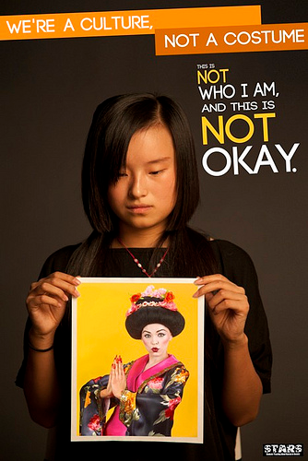
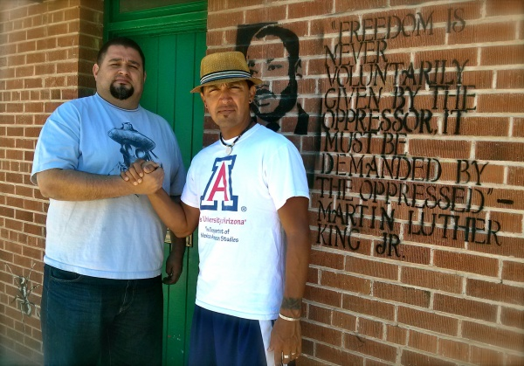
Professional Development: Race and Ethnicity on campus
“Cultural Appropriation vs. Cultural Appreciationa’ with Dalya Perez
“HB 1079 Students: How to Help” with Felis Peralta and Cecilia Martinez
“Quetzalcoatl: Precious Knowledge” with Sean Arce, Tucson Unified School District
“Whistling Vivaldi” Book study and workshop
“Cultural Competence and Student Retention” with Dr. Caprice Hollins

Slide 14
Student Veterans Subcommittee
Conducted survey of Veterans’ students needs
Planned Veterans information fair with speakers from WDVA
Co-planned Memorial Day and Veterans’ Day commemorations
Recommended:
More visibility for staff/faculty veterans
Space for student veterans
Staffing and resources around combat experiences, PTSD, transition issues, etc.

Slide 15
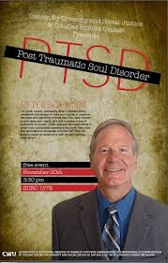
Professional Development:
“From Battlemind to Homemind” with Peter Schmidt, WDVA and Everett CC
Student veteran panel moderated by representatives of WDVA

Slide 16
Access Subcommittee
Goals: develop measure of students success for students with disabilities
Provide resources to faculty/staff in working with students with disabilities

Slide 17
Professional Development
“Learning Disabilities” workshop with Kathy Harrigan and Annamary Fitzgerald, Spring, 2012
“Deaf: Loud and Proud: Disabling the Disabled Model” with Dr. Tom Holcomb, Spring 2013

Slide 18
South Puget Sound Higher Education Diversity Partnership
Pacific Lutheran University
Collaboration of Higher Ed institutions in the south sound region (private, public, 2- and 4-year)
National speakers on diversity topics
DEAC sponsors 10-12 registrations for SPSCC employees each year

Slide 19
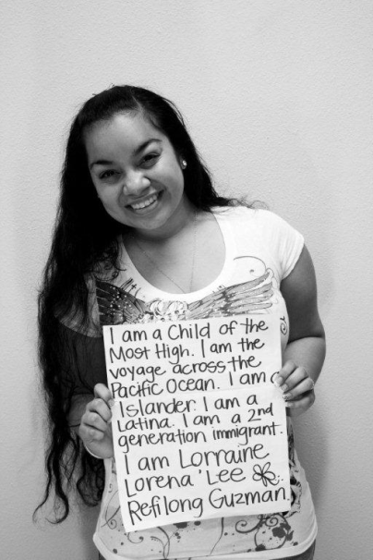
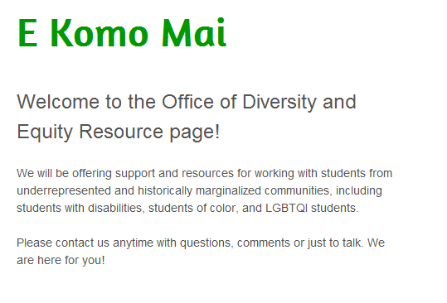
Resource Website
decspscc.weebly.com
Handouts and synopses of workshops
Videos
Other faculty and staff resources developed by the DEAC

Slide 20
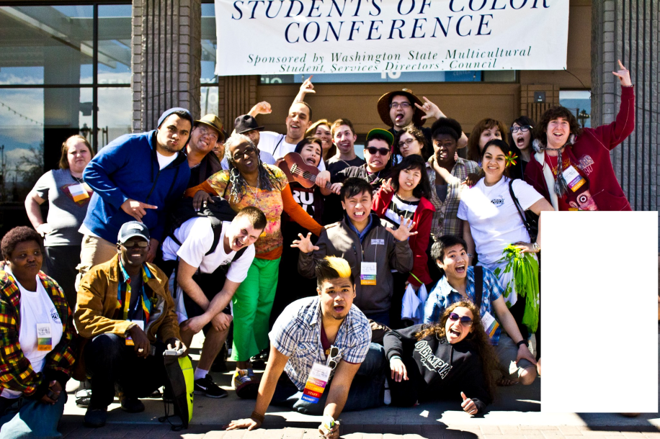
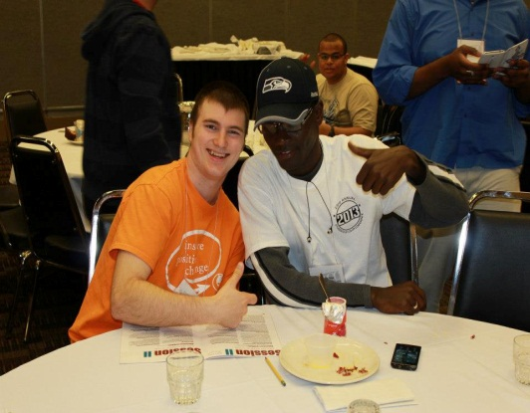
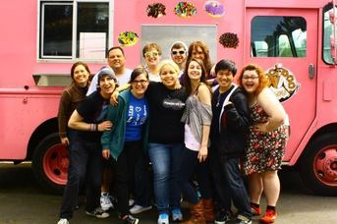
Mahalo nui loa!
“Every mind
is a world.”
--Cuban Proverb

