Slide 1
Learning Disabilities What Are They? How Can I Work With LD Students?
Annamary Fitzgerald & Kathy Harrigan
SPSCC Kick Off Week Workshop
September 20, 2012

Slide 2
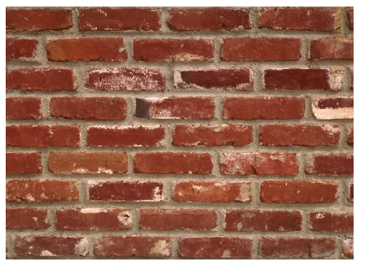

Slide 3
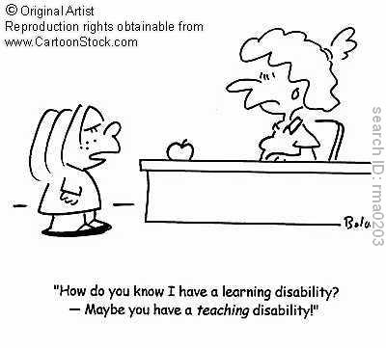

Slide 4
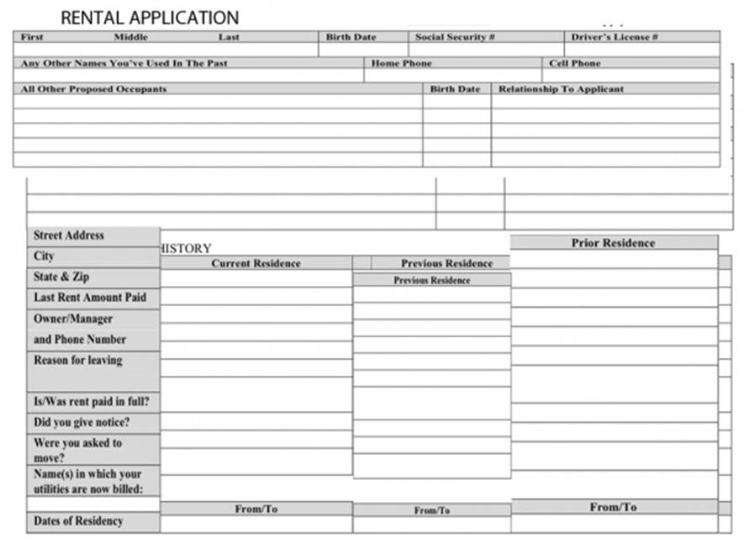

Slide 6
What Kinds of Students?
Think about a student who has been an enigma to you.
Did the student seem capable or even brilliant, yet not meet your expectations for achievement?
What did the student NOT learn or demonstrate?

Slide 7
Response to Intervention (RTI)
Student lack of response to offered instructional “interventions” may suggest a disability.
Disabilities may present in similar ways but have a variety of root causes.
This may be the way accommodations are allotted in higher education in the future.

Slide 8
Universal Design For Learning and Instruction
Ways to engage students and to design embedded instructional supports that gives most an opportunity to learn and show what they have learned in an inclusive environment.

Slide 9
Presentation Plan
Identify disabilities and disorders that are impacted by traditional learning models
Define and understand learning disabilities
Present UDL type strategies and instruction methods that can help most students in the classroom, as well as those with disabilities.

Slide 10
Disabilities and Disorders
Is what I’m seeing really
a Learning Disability?
Or is it something else?

Slide 11
So what is going on?
There are lots of potential reasons.
Mental Health
Physiological
Cognitive/Developmental
Other Issues
Learning Disabilities
Sometimes, these reasons overlap. Rarely are there clear-cut distinctions that identify as a single issue.

Slide 12
Mental Health Reasons
Depression
Anxiety
PTSD
Oppositional/Defiance Disorder
Personality Disorders
Antisocial
Borderline
Histrionic
Narcissistic

Slide 13
Physiological Reasons
Attention Deficit Disorder
Attention Deficit Hyperactivity Disorder
Obsessive/Compulsive Disorder (?)
Traumatic Brain Injury
Many more

Slide 14
Acquired/Cognitive/Developmental Reasons
Head Injury
Physical injury
Concussive trauma
Strokes
Seizure disorders
Borderline IQ (70-84)
Pregnancy or birth trauma
Early nutritional deficits
Chromosomal syndromes
Other syndromes

Slide 15
Other Reasons
Aspergers-Autism Spectrum Disorder
A disorder that affects a person's ability to socialize and communicate effectively with others.
People with this typically exhibit social awkwardness and an all-absorbing interest in specific topics.
Medication Interference
The inability to form memory because of chemical interference with neural networks.
Pain management
New medication
Medication change
Withdrawl
Self-Medication
Addiction

Slide 16
Learning Disability
It is a culturally-specific and medicalized Western concept.
Agrarian culture do not identify LD
LD is a term that has specific legal meaning in
academics
work situations

Slide 17
Learning Disability
Definition:
Student is of average or above-average intelligence (IQ 85+)
AND
Demonstrated academic ability falls substantially below expectations for age and/or education level
The issue is with “processing” information

Slide 18
Processing
Refers to how the brain
takes in uses stores
retrieves & expresses
information.
There are six categories of
processing that affect learning.

Slide 19
Processing Categories
Visual Processing
Auditory Processing
Sequential/Rational Processing
Conceptual/Holistic Processing
Processing Speed
Executive Function

Slide 20
Visual Processing
How well can a student use visual information?
See differences between things
Remember visual details
Fill in missing parts of a picture
Remember general characteristics
Visual-motor coordination
Visualize and imagine
Organize their materials, desk, room
Art ability

Slide 21
Visual Processing Disability Manifests most prominently in math and spelling - difficulty ‘visualizing’ words, letters, symbols, etc.
Writing
Poor handwriting
Poor spelling
Reading
Slow speed
Poor comprehension
Math
Difficulty visualizing problems
Difficulty with cluttered worksheets
General
Poor organization/planning/neatness
Difficulty rechecking work for accuracy
Difficulty learning by demonstration
Difficulty learning by video

Slide 22
Auditory Processing
How well can a student use auditory information?
hearing differences between sounds/voices
remembering specific words or numbers
remembering general sound patterns
understanding even when they miss some sounds
blending parts of words together
difficulty following oral directions
difficulty learning in lectures

Slide 23
Sequential/Rational Processing
It acts like the mail filing system for the brain to organize and memorize information.
Short-term memory for details
long-term retrieval of details
fine-motor coordination
finding the words you want to say or write
organization of your thoughts and materials
writing mechanics (spelling, punctuation)
reading speed/sounding out new words
attention to details
putting words and thoughts in order

Slide 24
Sequential/Rational Processing Disability Manifests most prominently in writing mechanics, basic reading, math computation, and expressive language.
Handwriting
Speed/clarity
Letter reversal/sequence
Spelling/Mechanics
Basic Reading
Decoding
Speed/fluency
Remembering details
Attention/concentration
Math computation
Remembering formulas/steps
Expressive Language
Finding words
General
Planning lengthy tasks/assignments
Following specific directions
General ability to focus – easily distracted by surroundings

Slide 25
Conceptual/Holistic Processing Discerns ‘the big picture,’ overall patterns and underlying concepts used in higher order thinking, creating, and reasoning.
memory for general themes or ideas
reasoning
spatial awareness
general knowledge
inferential thinking
estimation/ approximation
conceptual understanding
creativity/inventiveness
reading comprehension
use of context
rhythm
music
art

Slide 26
Conceptual/Holistic Processing Disability Manifests at a later age and most prominently in reading comprehension, math reasoning, and creative writing.
Reading
Understanding irony, inferences, sarcasm
General comprehension
Math computation
Generalizing to new situations
Story problems
Creative Writing
Ability to make up a story that isn’t ‘real’
General
General language comprehension
Understanding humor in general
Global/general awareness
Hyperattention – may focus too much on a specific area

Slide 27
Processing Speed How fast information travels through the brain.
short-term memory (with time pressure)
long-term retrieval (with time pressure)
reasoning (with time pressure)
general response speed
talking speed
word-finding
writing speed
reading speed
attention

Slide 28
Processing Speed Disability Students experiencing a general Processing Speed disability show difficulties in all academic areas.
Reading
Speed
Ability to stay focused
Math computation
Completing a series of problems
Written Language
Writing speed
Mechanics
Clarity (with time pressure)
Communication
Delays in responding
Slow, deliberate speech
Word-finding difficulties
General
Coping with implied or expressed time pressures
Always ‘a step behind’
Difficulty maintaining attention to tasks
Exceeding time limits during tests
Trouble with social pressures to perform ‘faster’

Slide 29
Executive Functioning The overall ability to manage or regulate cognitive and emotional process.
ability to stay focused on tasks
ability to plan and anticipate
organization of thoughts and materials
ability to follow-through and complete tasks
ability to cope with unstructured situations
ability to cope with changes in routine
ability to regulate emotions

Slide 30
Executive Function Disability Students struggle with work completion, organization, and motivation for any task seen as difficult, frustrating or unappealing. This weakness is associated with ADD.
Reading
Motivation when material is ‘boring’
Speed/fluency – skipping words or lines
Remembering details
Attention/concentration
Math computation
Difficulty seeing ‘relevance’
Difficulty maintaining motivation to complete practice worksheets
General
Planning lengthy assignments
Remembering details
Paying attention – easily distracted by surroundings
Completing assignments
Following specific directions
Ability to keep school a ‘priority’

Slide 31
In each of these categories, students can have trouble with
Input
Information is perceived through the senses. Difficulties with visual perception can cause problems with recognizing the shape, position and size. Problems with sequencing cause logic and time perception problems. Auditory perception distortion can interfere with focus.

Slide 32
Students can have trouble with
Integration
Input is interpreted, categorized, related to prior learning. Memorizing sequences of information, understanding new concepts, generalizing information to see the "big picture" can be impaired. A poor vocabulary may contribute to problems with comprehension.

Slide 33
Students can have trouble with
Storage
Most memory difficulties occur in the area of short-term memory, which can make it difficult to learn new material without many more repetitions than usual. Difficulties with visual memory can impede learning to spell.

Slide 34
Students can have trouble with
Output
Information comes out of the brain either through words, language output, or through muscle activity, such as gesturing, writing or drawing. Answering a question on demand or in writing, we must retrieve information from storage, organize thoughts, put the thoughts into words before we speak. People with fine motor difficulties may have trouble with handwriting.

Slide 35
Learning Disabilities
Broken down into specific task-related categories:
The main ones are:
Dyslexia
Dysgraphia
Dyscalculia
Specific Learning Disability (all three together)
These often occur together or in conjunction with other sorts of disabilities:
Mental Health
Physiological
Cognitive/Developmental
Other Reasons

Slide 36
Accommodations & Strategies
Help for LD and ADD

Slide 37
Learning Styles
Instruct to student strengths to help students accommodate weaknesses.
Ask how a student learns something new:
Read about it
Someone tell you
Someone show you
Do it yourself
Their answers let you present in a multi-sensory way:
Visually with pictures or symbols
Orally with lecture/explanation
Hands-on with demonstration/active participation

Slide 38
General Strategies
Be consistent & approachable
Provide structure, but be flexible
Be prepared to repeat and repeat
Sequence everything that can be sequenced
Anticipate student needs

Slide 39
General Strategies
Provide multiple ways for the student to get information
Provide multiple ways for the student to show mastery
Don’t make tests high stakes – test incrementally to determine learning of parts
Plan to adjust instruction to address assessed deficits

Slide 40
General Strategies
Remember that Learning Disabilities are life-long and that inconsistency is a hallmark of LD
Acknowledge to yourself that both you and the student can sometimes feel overwhelmed by the learning challenge

Slide 41
Specific Tips
Provide help filling out forms—often especially challenging to LD students
ScanTron forms
Registration/Graduation forms
Advising forms
Applications
Tables

Slide 42
Specific Tips
Break things into small, sequential steps
Even though it may seem simplistic and redundant, students with LD or attention deficits benefit from sequencing help.
Give details—it helps with memory.

Slide 43
Specific Tips
Calendars – Provide for Organization
Encourage students to use a calendar—provide a blank, quarterly calendar on your class site for them.
List homework for each day on the class calendar.
Provide a due date calendar along with the class calendar.
Review class calendar with students on a daily and weekly basis—time management is also a problem for most LD students.
Discuss upcoming projects and time that will be involved for students outside of class.

Slide 44
Specific Tips
Directions need to be clear, simple, and in order—for everything.
Clarify the important information:
Stress it
Repeat it
Paraphrase it
Review it
Have students repeat it

Slide 45
Specific Tips
Explain unfamiliar words
Read information out loud
Use printing, not cursive, writing—deciphering cursive is difficult for some students and it is on its way out.

Slide 46
Specific Tips
Speak clearly and slowly for the lowest level of understanding.
Think of the 40 mile per hour student…they can get it if they can keep up with you.
Extra time is critical to the success of most students with LD.
A slow, clear voice also soothes.

Slide 47
Specific Tips
Be prepared and patient about repeating answers you have given to questions that are also repeated.
Discouraging repeat questions will create discouraged learners.
Repetition is critical to LD learners.

Slide 48
Specific Tips
Keep students on track by bringing them back to the issue at hand; structure is critical to LD learners. Avoid side trips in lectures.
Suggest digital recorders for students who have trouble writing notes
Have everything you want to emphasize in hard print or well organized online so that students can review it in written form.
Tegrity provides a visual and auditory record.

Slide 49
Specific Tips
When explaining something, give visual cues as much as possible.
Draw maps, graphs, or concepts.
Use graphic organizers and encourage students to make their own—like Venn Diagrams.
Encourage students to use mental pictures—especially if they identified themselves as visual learners.

Slide 50
Specific Tips
Non-confident learners can easily shut down. Choose casual language over direct questioning to get information.
Be careful about using “demand” language like, “Why did you do that?”
Instead, use language that engages students in conversation like, “Let’s figure out what happened here.”

Slide 51
Specific Tips
Avoid sarcasm or jokes
Abstractions are sometimes difficult for LD and Asperger students
Students can be sensitive and assume the joke is about them

Slide 52
Specific Tips
Spelling may be poor, but ideas strong.
When possible, tell students that spelling doesn’t count on drafts, or at all.
Encourage spell-checkers.
Consider what you want them to show you and look beyond spelling problems if you can.
Encourage association for memory recall—
use songs, rhymes, acronyms, chants.

Slide 53
Specific Tips
Reading italic print or unusual fonts can be hard for some; use bold or underlining or highlighting instead.
Suggest using a ruler or an index card with a cut-out if they have trouble tracking when reading.

Slide 54
Specific Tips
Post-it notes can function as a “paper brain.” Encourage their use for notes in books, for reminders of assignments, and more.
Print materials on pastel paper when you can—some are sensitive to the contrast of bright white and black ink. Recycled white is less offensive—off white.

Slide 55
Specific Tips
Irlen filters
Some students benefit from them
Any colored transparent plastic can work
These can cut glare and give harder edges to print.

Slide 56
Specific Tips
Allow or embed moving or walking (or tactile toys) moments into your class time.
This is helpful when students have trouble paying attention, focusing
Think—active/passive/active/passive
Reduce visual or noisy distractions where students are working.
Encourage distractable students to sit near the front-- or near you.

Slide 57
Specific Tips
Give frequent breaks.
Every 15-20 minutes break OR make a shift in mode of instruction.
Television has conditioned us to breaks every
8 minutes or so.
After providing information, check in to see if they have learned it.
Ask them to repeat or summarize it.

Slide 58
Specific Tips
Provide multiple ways that students can show mastery of a subject or task whenever possible; oral presentation, paper, video, artistic or 3-D project, interview outside class, etc…..
Provide immediate positively delivered feedback.
Be clear about areas that need improvement.
Be patient and flexible.

Slide 59
Print Tips-Online and Not
Display information in a format that is easy to comprehend. Think about:
contrast between background and text or image
color used for information or emphasis
volume or rate of speech or sound
speed or timing of video, animation, sound,
layout of elements
font type
size of text, images, graphs, tables, pictures

Slide 60
How Can Students Show Learning without Writing or Testing?

Slide 61
Peristalsis is “the progressive wave of contraction and relaxation of a tubular muscular system, especially the alimentary canal, by which the contents are forced through the system.” You can express this by…

Slide 62
a haiku
a cubist-style sketch or collage
a letter of complaint
an origami folded paper model
a 1930s radio broadcast
a love song
a marriage vow
a story a Dear John letter
a puppet show
a children's book
a choreographed fight scene
an interpretive dance
an obituary
a public service announcement
a proverb
a cartoon
a calendar design
a heated dialogue between enemies
a bumper sticker

Slide 63
a playdough/modelling clay scultpure
a series of 5 photographs
a sketch with non-dominant (left) hand
a concept map
an expressive dance
an album cover
an impressionistic painting
A sonnet
A nursery rhyme
A game of charades
A board game
A rap/hip-hop song
a charts or a graph
A rap of your own making
A tattoo design
A show & tell event
A word cloud in Wordle
A floor plan of a house with appropriate labels

Slide 64
A Few Resources
Hand out with sample of websites that help with UDL/UDI—especially for students.
CAST.org
DoIt.org
LD.org

Slide 65
Questions?

